Slide 1




Test Case Postman by Muhammad Hadi

Slide 2
ROADMAP
SMALL PROJECT 1
YOU ARE
IN HERE NOW
GRADUATION
1
3
5
2
4
6
SMALL PROJECT 2
FINAL PROJECT
WORK

Slide 3
PRE-REQUIREMENT
Chrome (www.orangehrm.github.io/orangehrm-api-doc)
Postman
Newman

Slide 4
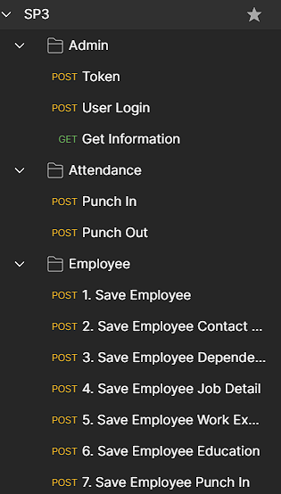
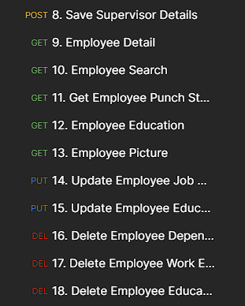



LIST TEST CASE
23 Test Case

Slide 5
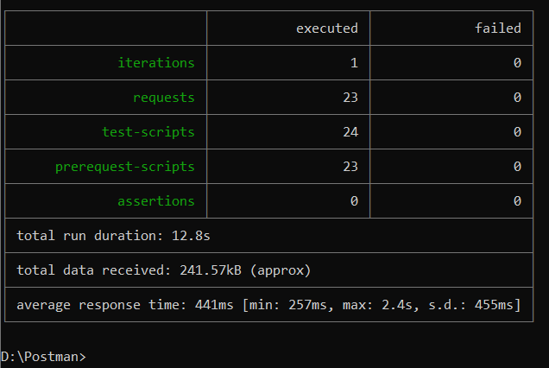
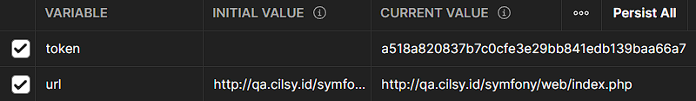
NEWMAN
Variable

Slide 6
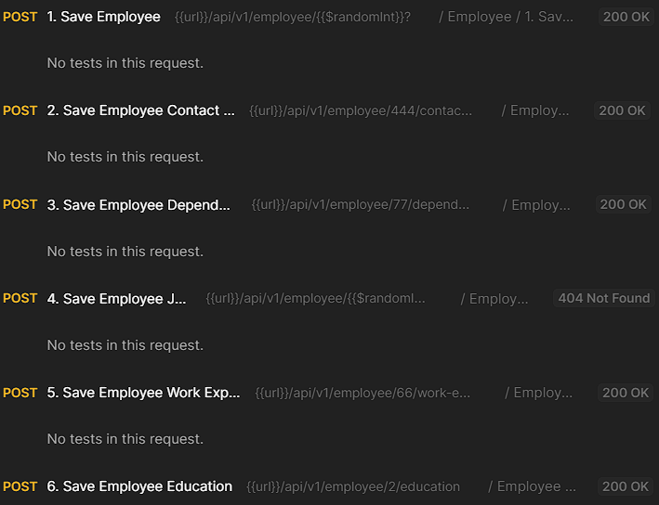
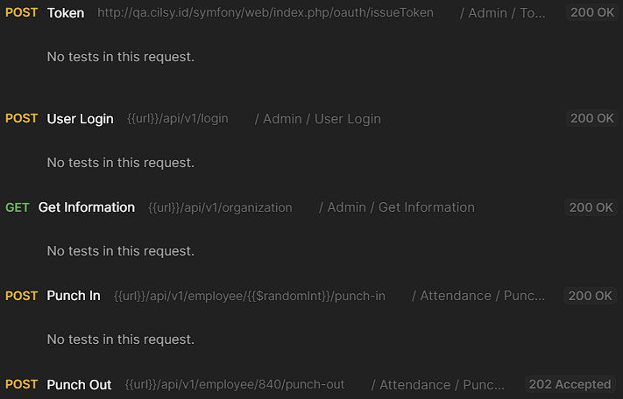
RUN COLLECTION

Slide 7
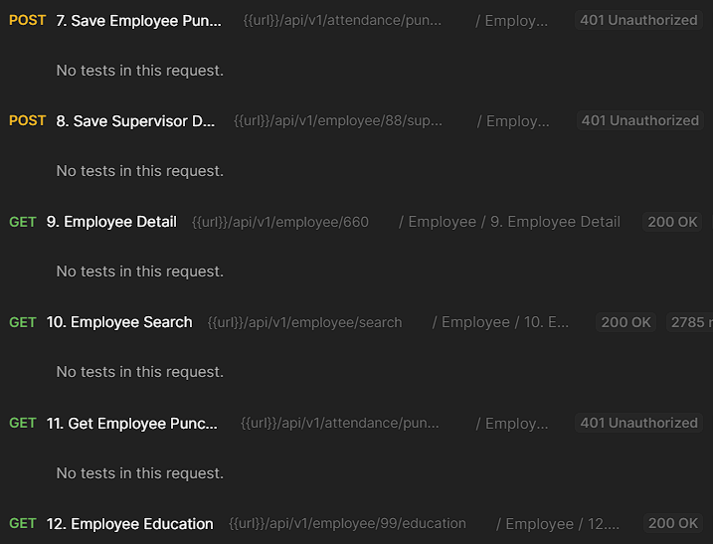
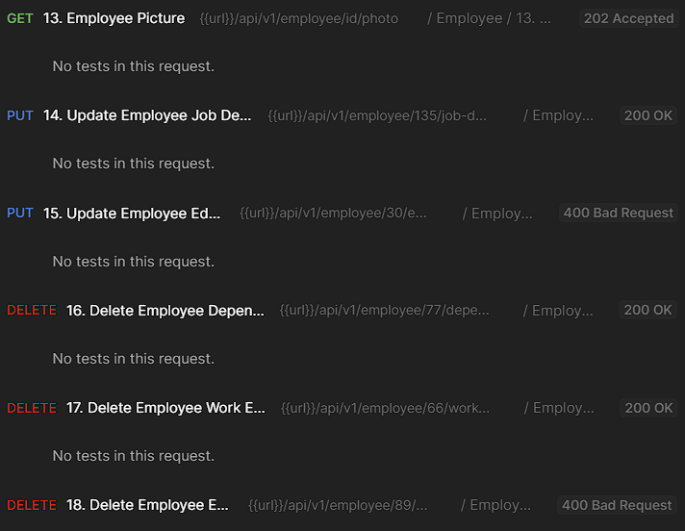
RUN COLLECTION

Slide 8
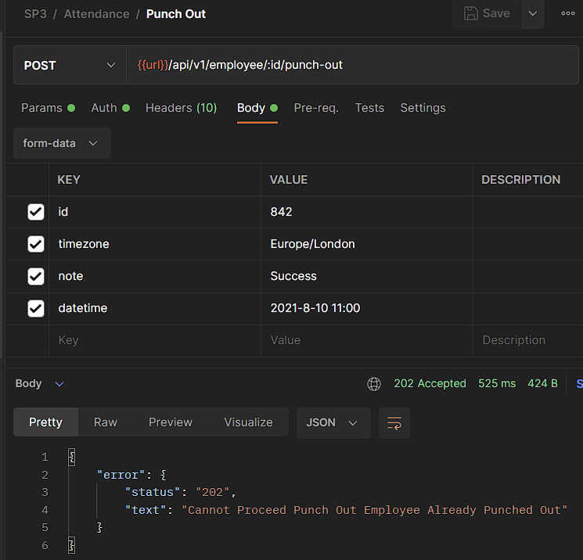
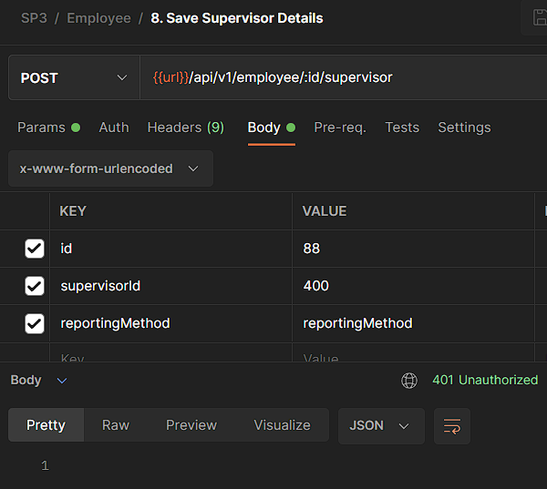

NEGATIVE TEST CASE

Slide 9
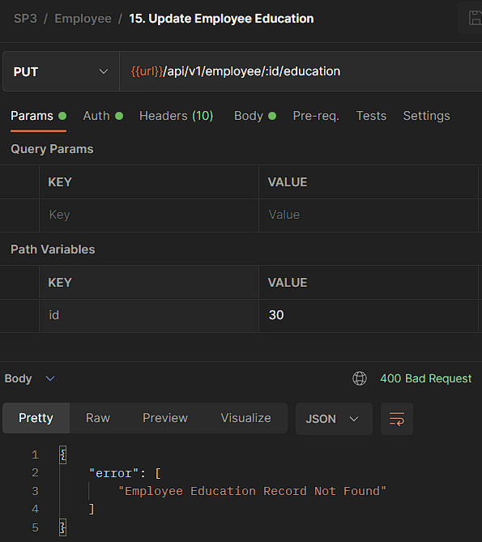
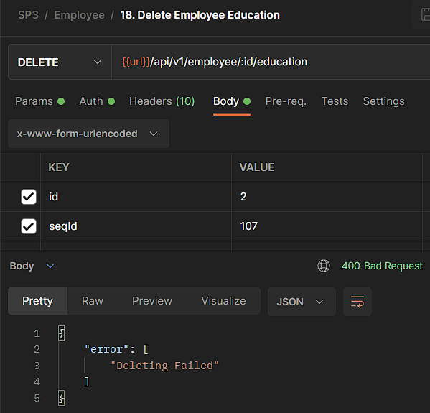
NEGATIVE TEST CASE

Slide 10
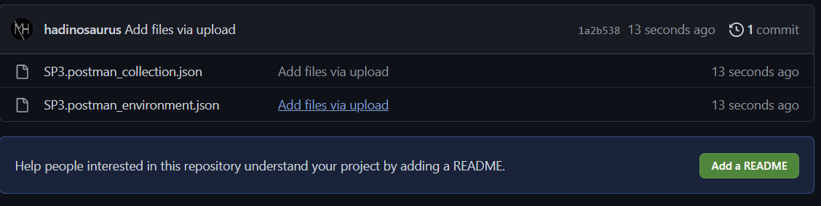
GITHUB
LINK GITHUB:
https://github.com/hadinosaurus/SP3-Cilsy/

Slide 11

Hatur Nuhun
You can find me at:
Instagram/Twitter/Github/Line/Spotify:
hadinosaurus
Facebook/YouTube/LinkedIn: Muhammad Hadi Nugroho

